Slide 1
Easy accessibility plan for Glasgow Science Centre
TEAM 10

Slide 2
Content
Challenge statement
Accessibility goals
Our idea
Back-end & front-end design plans
UX & UI goals
Complications
Demo
Additional features

Slide 3

The Challenge Statement
Can you create a mobile or web app (a digital product) that would make the Glasgow Science Centre (GSC) experience more accessible to those with any disability?

Slide 4

What did we decide to create?
Replicate as closely as possible the originally intended experience and suit it for disabled people
Ability to see what exhibits are accessible and ability to plan accordingly
Highlighting the science behind each exhibit

Slide 5
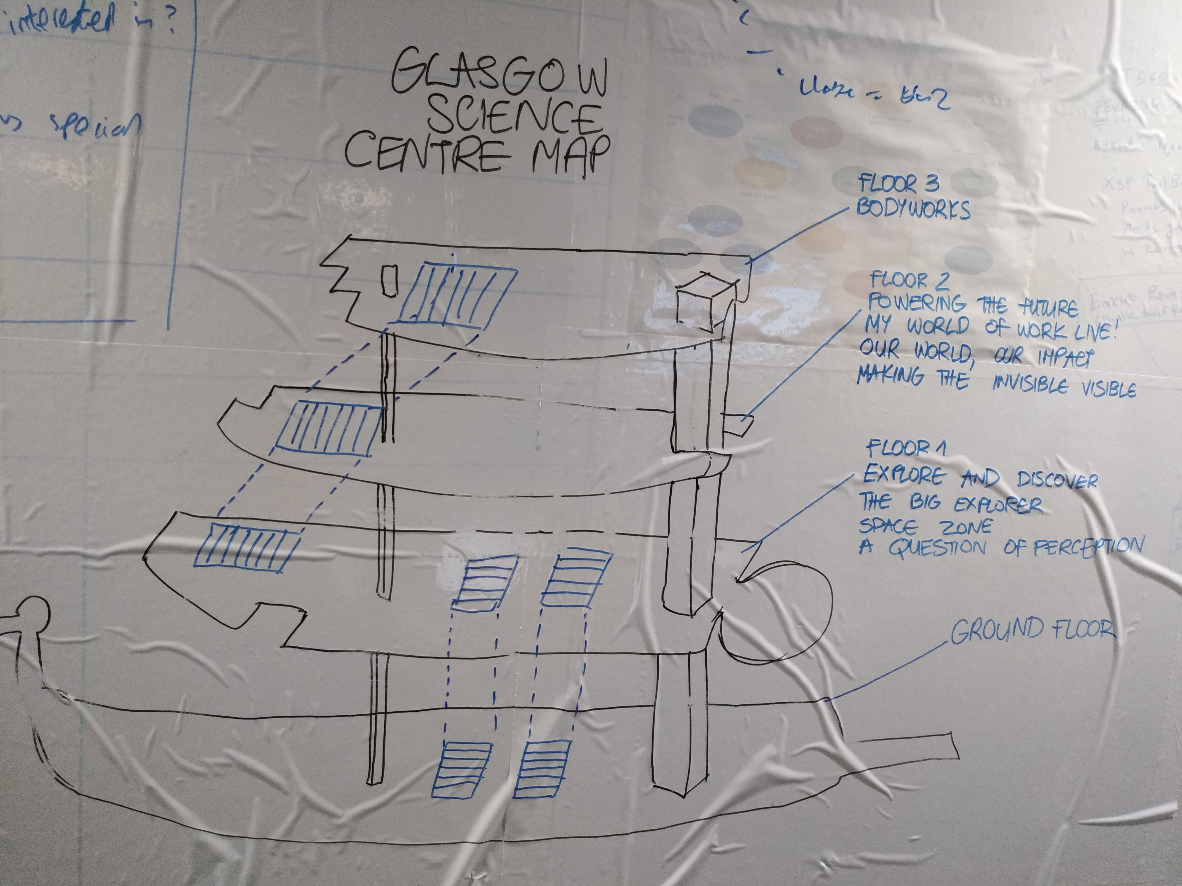
What did we decide to create?
A tool to guide visitors around the GSC
Interactive map
Ability to see instantly what kind (audio, visual, physical, etc.) of exhibits are available
Further exhibit information provided once it is clicked on
Suggested routes

Slide 6
Original Stack choice
Discussed each member’s strengths
Ruby on Rails
Bootstrap and plain HTML/JavaScript (jQuery)
MySQL database

Slide 7
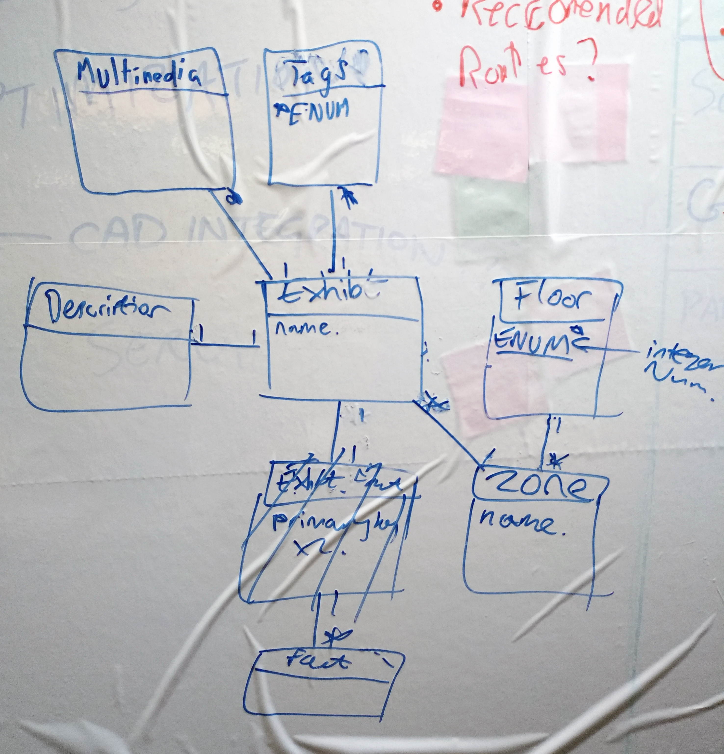
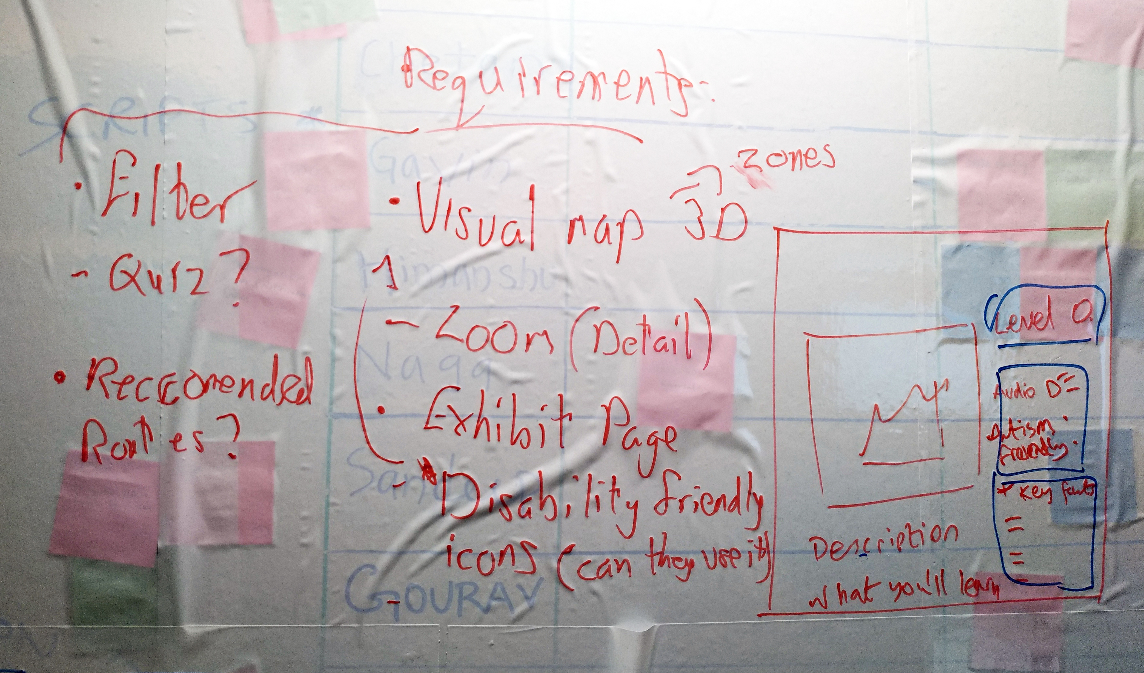
Back-end design plan
ER Diagram
Relational database
Population script

Slide 8
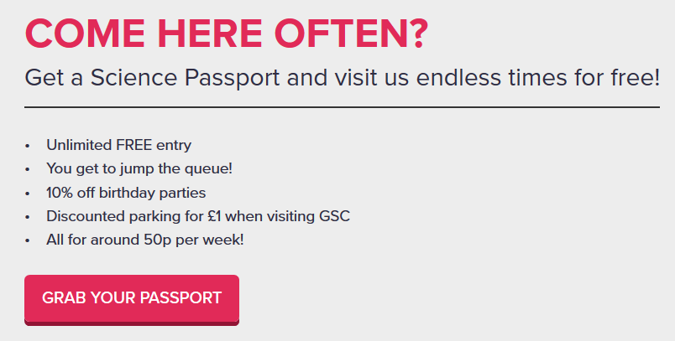
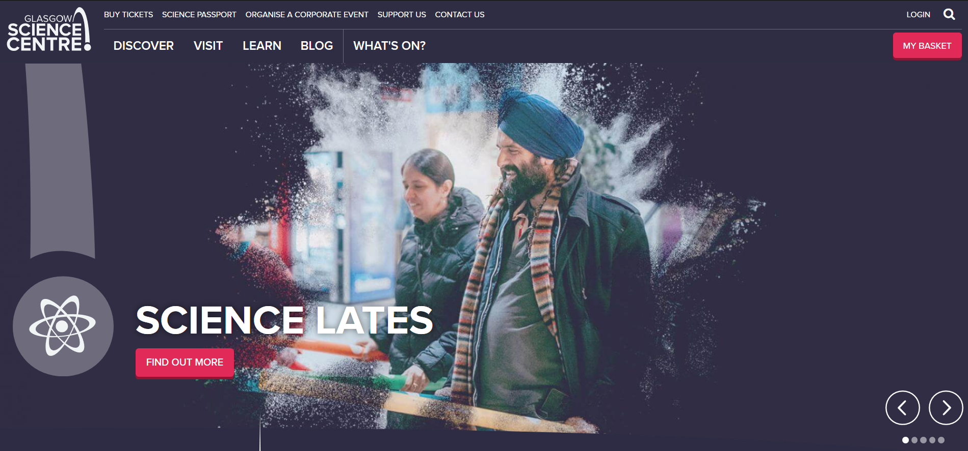
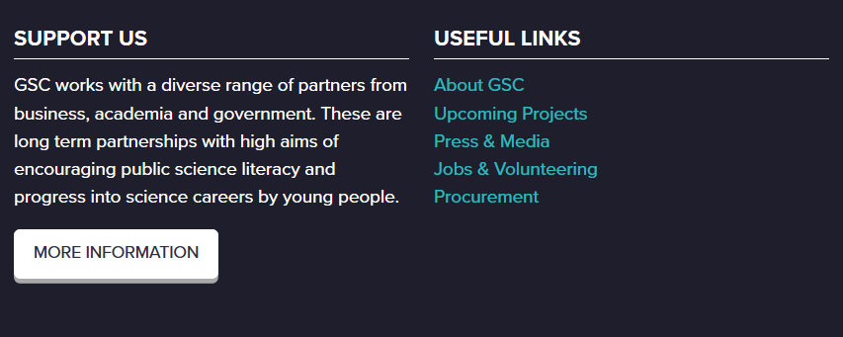
UI design decisions
Screen the website’s design
Follow brand guidelines

Slide 9
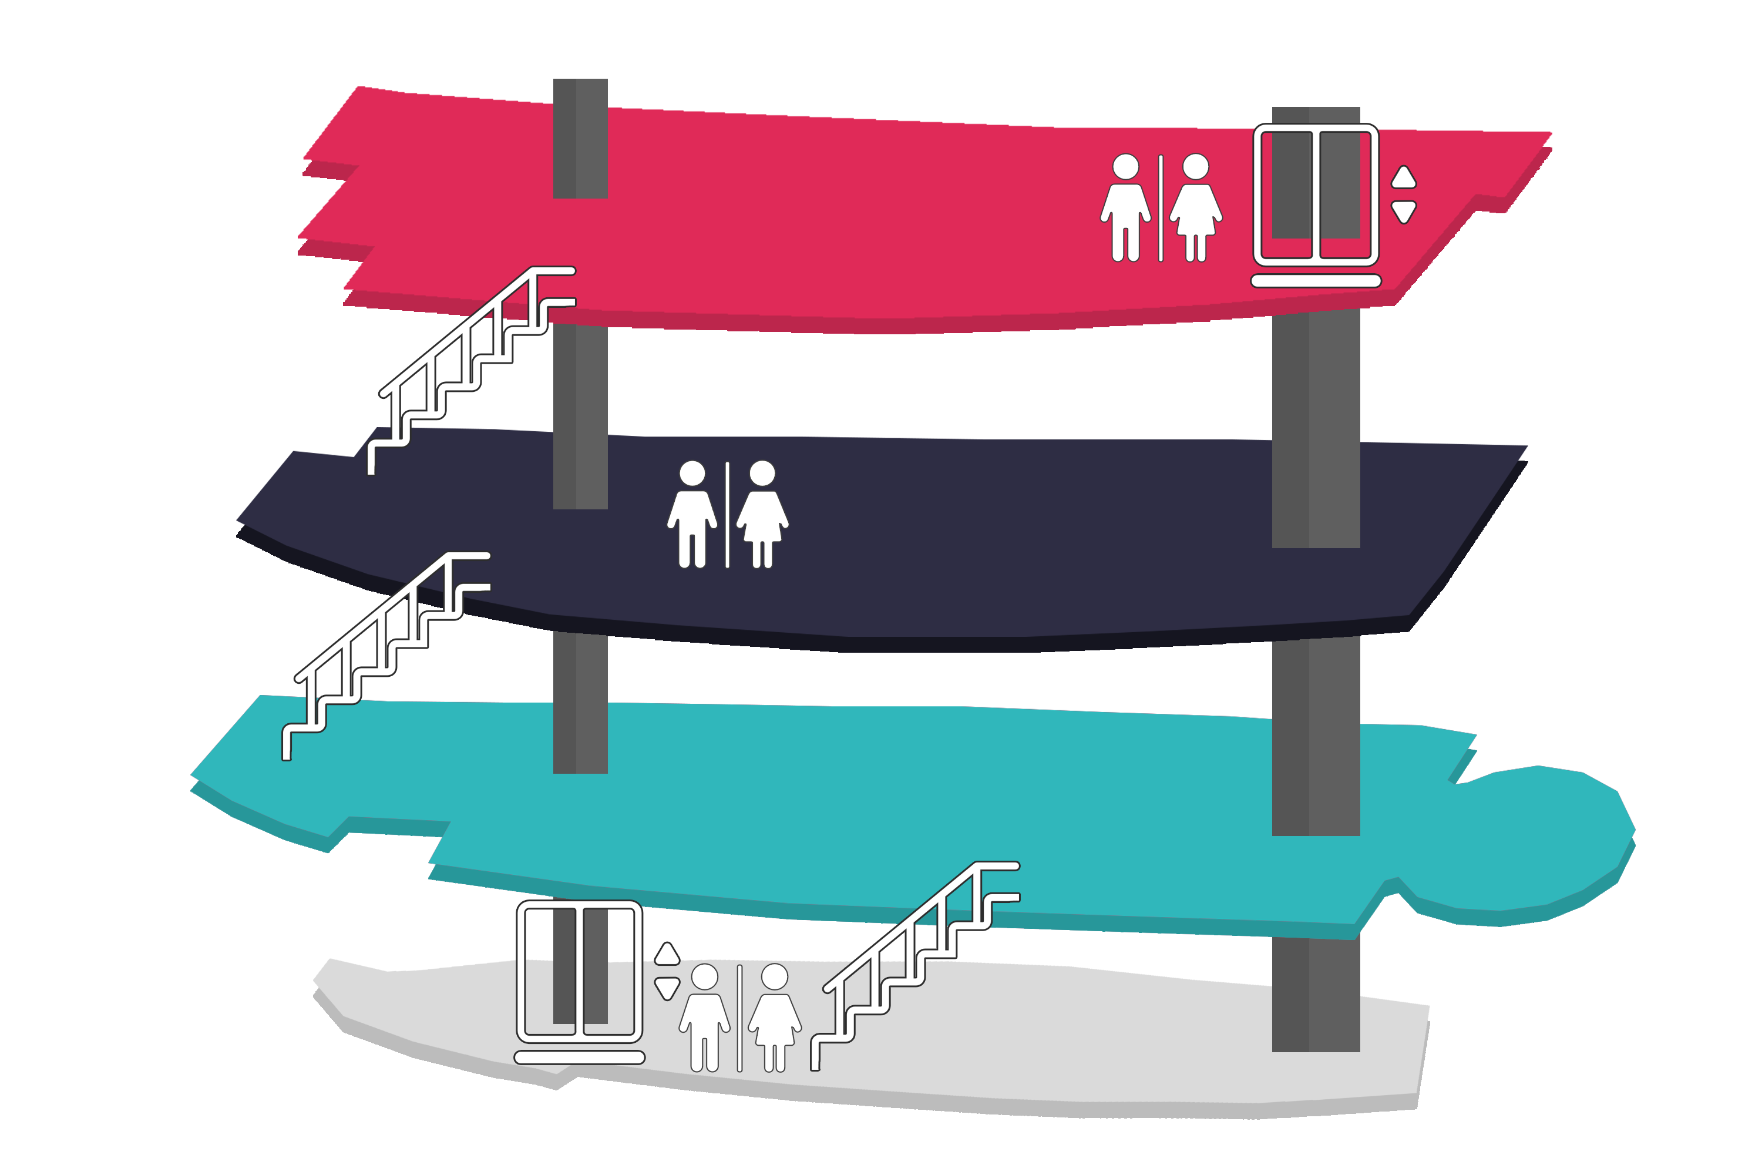
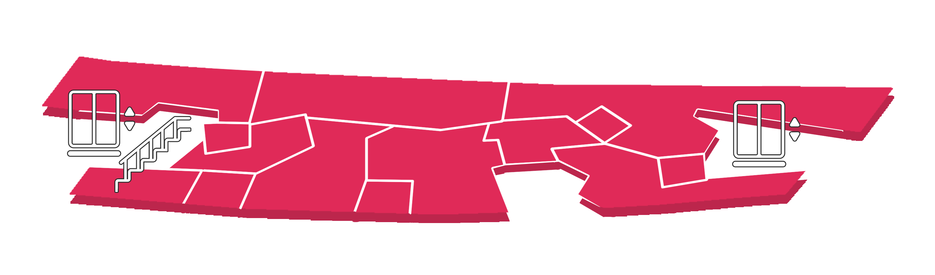

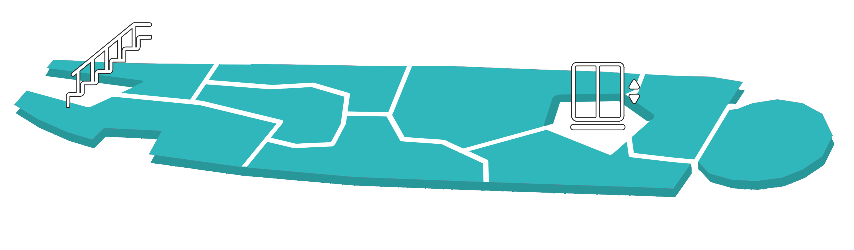
UI design decisions
Exciting, bold, simplistic
Suited for people with cognitive disabilities

Slide 10
Complications
Unfamiliarity with technology
Difficulty creating image maps
Research suggested to switch to React
Lack of time
Integrate back-end with front-end

Slide 11
Demo

Slide 12
If we had more time…
More detailed, zoomable map, 3D models
Full tag implementation
Automatic optimal route planning
Preference or interests quiz

Slide 13

Questions?

